Slide 1


Slide 2
What is an API
Definition: API stands for Application Programming Interface
Acts as a bridge between two software applications
Enables data exchange and functionality sharing
Example: Google Maps API used in ride-sharing apps

Slide 3
Why we need APIs
1. System Integration: APIs connect different systems and platforms
Example: A CRM system integrates with an email service via API
2. Reusability of Functionality: Developers can reuse existing services without rebuilding them
Example: Google Maps API used in delivery apps
3. Faster Development: APIs simplify coding by exposing ready-to-use services
Example: Payment APIs like Stripe or PayPal reduce development time

Slide 4
Why we need APIs
4. Third-Party Collaboration: APIs allow external developers to build on your platform
Example: Twitter API lets developers create analytics tools
5. Data Accessibility: APIs enable secure and structured access to data
Example: Financial APIs provide real-time stock data to trading apps

Slide 5
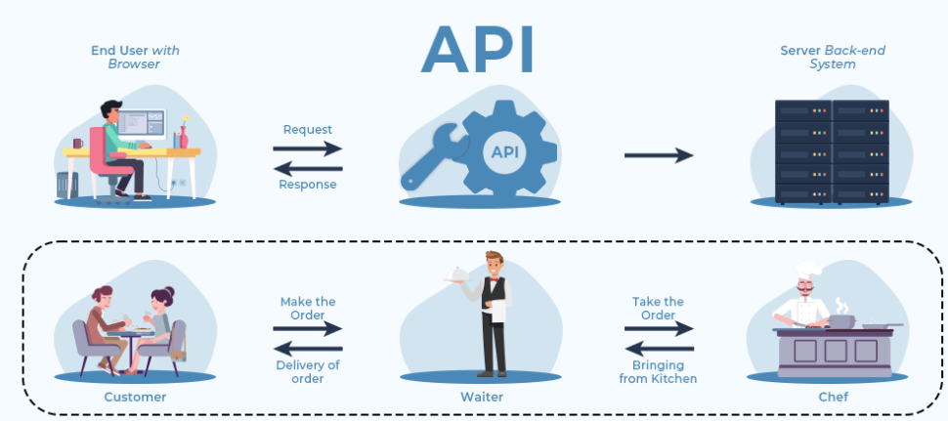
How APIs work
Client sends request to API endpoint
API processes the request
Server responds with data or action
Client receives structured response (usually JSON)

Slide 6
Commonly used APIs
API Provider | Use Case
Google Maps | Location tracking, route planning
PayPal | Online payments and subscriptions
OpenWeatherMap | Real-time weather data for apps
Spotify API | Music streaming and playlist management
Amazon S3 | Cloud storage and file access

Slide 7
Different Types of APIs – Access levels
Type | Audience | Access Level | Common Use Case
Open API | Public | Minimal restriction | Third-party app development
Internal API | Organization | Restricted | Internal system integration
Partner API | Business partners | Controlled | B2B data sharing
Composite API | Developers | Varies | Aggregated data from multiple sources

Slide 8
Types of APIs – Based on Protocols
API Style | Description | Example Use Case
REST | Stateless, uses HTTP methods | Most modern web services (e.g., GitHub)
SOAP | XML-based, strict structure | Enterprise apps like banking systems
GraphQL | Flexible queries, client controls data shape | Facebook APIs, Shopify
gRPC | High-performance, binary format, uses Protocol Buffers | Microservices in large-scale systems

Slide 9
REST APIs
REST (Representational State Transfer) is an architectural style for designing networked applications. A REST API (or RESTful API) allows systems to communicate over HTTP using standardized methods.
Key Concepts:
Client: The application making the request (e.g., browser, mobile app)
Server: The system hosting the resource
Resource: Any data object (e.g., user, product, post)
Representation: The format in which data is returned (usually JSON or XML)

Slide 10
Features of REST APIs
Stateless: Each request contains all necessary information; no session is stored on the server
Cacheable: Responses can be cached to improve performance
Uniform Interface: Consistent structure using URIs and HTTP methods
Layered System: Can be deployed across multiple layers for scalability
Client-Server Architecture: Separation of concerns between client and server

Slide 11
Feature | Description
Stateless | No session data stored on server; each request is self-contained
Cacheable | Responses can be cached to improve performance
Uniform Interface | Consistent use of URIs, methods, and status codes
Layered System | APIs can be deployed across multiple layers for scalability and security
Client-Server Model | Separation of concerns between client and server

Slide 12
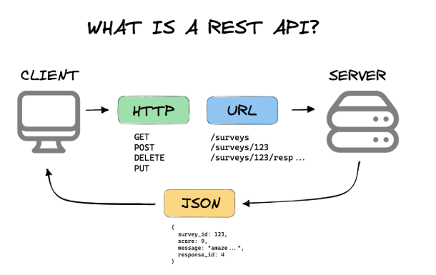
How REST APIs Work
Client-Server Communication: The client sends a request to the server using a specific HTTP method (GET, POST, PUT, DELETE).
The server processes the request and returns a response, usually in JSON format.
Resources and URIs: A resource is any data object (e.g., user, product, post).Each resource is identified by a URI (Uniform Resource Identifier).Example: /users/123 refers to the user with ID 123.

Slide 13
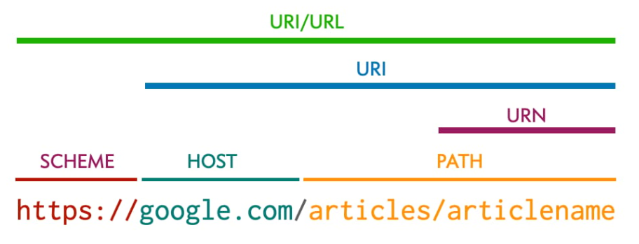
URN, URL and URI

Slide 14
Types of HTTPS Methods in REST APIs
HTTP Method | CRUD Operation | Description | Example Request
GET | Read | Retrieve data | GET /products/101
POST | Create | Add new data | POST /products
PUT | Update | Replace existing data | PUT /products/101
PATCH | Update | Modify part of existing data | PATCH /products/101
DELETE | Delete | Remove data | DELETE /products/101

Slide 15
SOAP APIs
SOAP (Simple Object Access Protocol) is a protocol for exchanging structured information in web services. It uses XML to encode messages and relies on HTTP or SMTP for transport.
Key Characteristics:
Protocol-based (not just architectural like REST)
Strict standards defined by W3C
Platform and language independent
Built-in error handling and security features

Slide 16
Features of SOAP APIs
Strong typing via XML Schema
Built-in error handling with <soap:Fault>
WS-Security for authentication and encryption
Extensibility through custom headers
Transport independence (can use HTTP, SMTP, etc.)

Slide 17
Feature | Description | Benefit
Protocol-Based | SOAP is a formal protocol with strict standards defined by W3C | Ensures consistency and reliability across platforms
XML Messaging | All messages are encoded in XML format | Platform-independent and human-readable
Envelope Structure | Messages are wrapped in a SOAP envelope with optional header and mandatory body | Organizes message content and metadata cleanly
Transport Flexibility | Can use HTTP, SMTP, TCP, or UDP for message transport | Works across diverse network environments
WS-Security Support | Built-in support for encryption, authentication, and digital signatures | Ensures secure data transmission
Extensibility | Allows custom headers and elements for additional functionality | Can be adapted for complex enterprise needs
Reliable Messaging | Supports message delivery guarantees and acknowledgment mechanisms | Ensures messages are delivered in correct order
Error Handling | Uses <soap:Fault> element to return detailed error information | Provides structured and informative error responses
Platform Independence | Works across different operating systems and programming languages | Ideal for heterogeneous enterprise environments
Strong Typing | Uses XML Schema for defining data types | Reduces ambiguity and enforces data integrity
RPC Support | Can perform Remote Procedure Calls (RPC) via XML | Enables function-like interactions between systems
Firewall Friendly | Operates over HTTP, which is commonly allowed through firewalls | Easy to deploy in secure environments

Slide 18
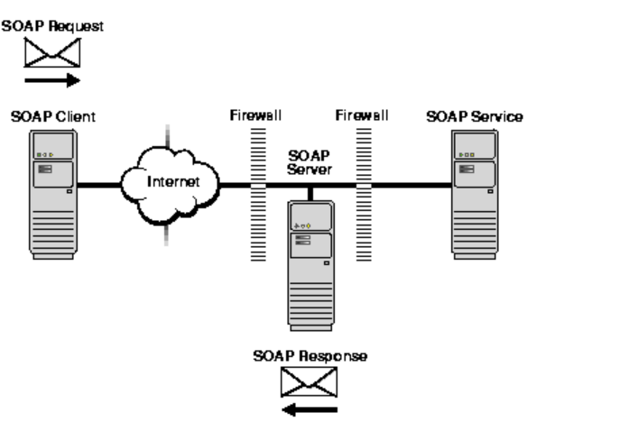
How SOAP APIs work
SOAP uses XML as the data format for messages being sent and received by an API client, and it provides four distinct dimensions to the API protocol:
Envelope: Defining the structure of the message.
Encoding: Rules for expressing the type of data.
Requests: How each SOAP API request is structured.
Responses: How each SOAP API response is structured.

Slide 19
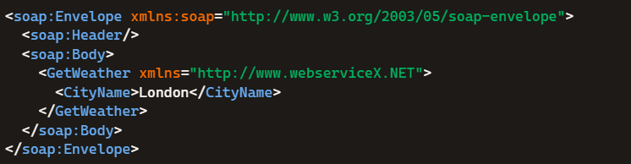
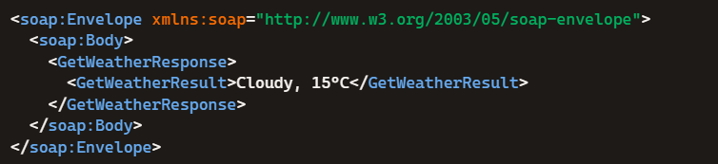
Example
Request
Response

Slide 20
API Testing
API Testing is a type of software testing that focuses on verifying that an application's Application Programming Interfaces (APIs) work as expected. It ensures that APIs:
Return correct responses
Handle errors gracefully
Perform efficiently
Are secure and scalable
Unlike UI testing, API testing is performed at the integration level, often before the UI is developed.

Slide 21
How API Testing Works
Understand API specifications (Swagger, WSDL, etc.)
1
Send requests using HTTP methods (GET, POST, PUT, DELETE)
2
Validate responses (status code, headers, body)
3
Automate tests using tools like Postman or REST Assured
4
Integrate with CI/CD pipelines
5

Slide 22
Types of API Testing
Type | Purpose
Functional Testing | Validates API behavior and output
Security Testing | Checks for vulnerabilities and access control
Load Testing | Measures performance under stress
Validation Testing | Ensures correct data formats and values
Error Testing | Verifies handling of invalid inputs
UI Integration | Confirms API works with front-end components

Slide 23
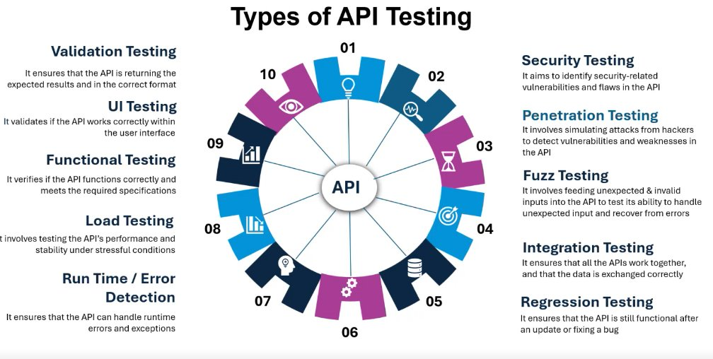

Slide 24
Popular API Testing Tools
Tool | Features
Postman | Manual testing, scripting, automation
REST Assured | Java-based automation framework
SoapUI | SOAP and REST testing
JMeter | Performance testing for APIs
Karate | BDD-style API testing

Slide 25
What to Validate in API Testing
Element | What to Check
Status Code | 200, 201, 400, 401, 500, etc.
Headers | Content-Type, Authorization
Body | JSON structure, field values
Time | Response time in milliseconds

Slide 26
HTTP Response Codes
Category | Range | Meaning
1xx | 100–199 | Informational responses
2xx | 200–299 | Successful responses
3xx | 300–399 | Redirection messages
4xx | 400–499 | Client error responses
5xx | 500–599 | Server error responses

Slide 27
2xx – Success Codes
Code | Meaning | Description
200 | OK | Request succeeded
201 | Created | Resource created successfully
204 | No Content | Request succeeded, no content returned

Slide 28
Slide 5: 3xx – Redirection Codes
Code | Meaning | Description
301 | Moved Permanently | Resource moved to a new URL
302 | Found | Temporary redirect
304 | Not Modified | Cached version is still valid

Slide 29
4xx – Client Error Codes
Code | Meaning | Description
400 | Bad Request | Malformed syntax or invalid request
401 | Unauthorized | Authentication required
403 | Forbidden | Access denied
404 | Not Found | Resource not found
429 | Too Many Requests | Rate limit exceeded

Slide 30
5xx – Server Error Codes
Code | Meaning | Description
500 | Internal Server Error | Generic server failure
502 | Bad Gateway | Invalid response from upstream server
503 | Service Unavailable | Server is down or overloaded
504 | Gateway Timeout | Upstream server didn’t respond in time

Slide 31
Components of an API Request
Component | Description | Example
Endpoint (URL) | The full URL that identifies the resource or service | https://api.openai.com/v1/chat/completions
HTTP Method | Specifies the type of action to perform | GET, POST, PUT, DELETE, PATCH
Headers | Metadata sent with the request (e.g., authentication, content type) | Authorization: Bearer <token>
Query Parameters | Key-value pairs appended to the URL for filtering or customization | ?limit=10&sort=desc
Request Body | Data sent with the request (usually in POST, PUT, or PATCH methods) | JSON payload
Authentication | Credentials or tokens to verify identity and access | API key, OAuth token, JWT
Content Type | Specifies the format of the request body | application/json

Slide 32
Rest Assured
REST Assured is a Java-based library for testing RESTful APIs
It provides a domain-specific language (DSL) for writing readable and maintainable tests
Integrates seamlessly with JUnit, TestNG, and Maven

Slide 33
Why Use REST Assured
Automates REST API testing with minimal boilerplate
Supports authentication (Basic, OAuth, etc.)
Validates status codes, headers, and response bodies
Easily integrates with CI/CD pipelines
Ideal for microservices and BDD-style testing

Slide 34
REST Assured Architecture
Built on top of HTTP Client libraries
Uses Fluent API for chaining requests and assertions
Works with JSON, XML, and HTML responses
Compatible with Hamcrest matchers for assertions

Slide 35
Key Features of Rest Assured
Feature | Description
given() | Sets up request parameters, headers, body
when() | Defines the HTTP method and endpoint
then() | Validates response status, headers, body
extract() | Retrieves values from the response
path() | Navigates JSON/XML response structure

Slide 36

import io.restassured.RestAssured;
import static io.restassured.RestAssured.*;
import static org.hamcrest.Matchers.*;
public class SampleTest {
@Test
public void testStatusCode() {
given().
baseUri("https://api.example.com").
when().
get("/users/1").
then().
statusCode(200).
body("name", equalTo("John Doe"));
}
}

Slide 37
import static io.restassured.RestAssured.*;​
import static org.hamcrest.Matchers.*;​
import org.junit.Test;​
​
public class SimpleGetTest {​
@Test​
public void checkStatusCode() {​
given().​
body(requestBody).​
contentType("application/json").​
when().​
put/post("https://jsonplaceholder.typicode.com/posts").​
then().​
statusCode(201); // POST usually returns 201 forcreated​
}​

Slide 38
Building your request body – JSON
JSONObject data = new JSONObject();​
data.put(“name”, “Selenium”);​
data.put(“location”, “desktop”);​
data.put("version”, 4.4);​
String otherSW [] = {“Java”, “SQL”};​
data.put(“SW”, otherSW);​
​//build your request with the jsonobject
given()​
.contentType(“application/json”)​
.body(data.toString())​

Slide 39
Authentication and Authorization
Authentication can be in the form of ​
Username and a Password​
Authentication tokens​
Secret keys​
Bio-metrics and many other ways​
This credential setting is generally passed in the headerfield of an HTTP request.​

Slide 40
Types of Authentication - Basic
Sends username and password encoded in Base64
Not secure over plain HTTP—use HTTPS
Example:
given()
.auth().basic("admin", "password123")
.when()
.get("https://api.example.com/secure-data")
.then()
.statusCode(200);

Slide 41
Types of Authentication - Digest
More secure than Basic Auth
Uses hashing algorithms like MD5 or SHA-256
Example:
given()
.auth().digest("admin", "password123")
.when()
.get("https://api.example.com/digest-protected")
.then()
.statusCode(200);

Slide 42
Types of Authentication - Form
Simulates login via HTML form
Useful for testing web apps with login pages
Example:
given()
.auth().form("admin", "password123", FormAuthConfig.formAuthConfig()
.withAction("/login")
.withUserField("username")
.withPasswordField("password"))
.when()
.get("https://webapp.example.com/dashboard")
.then()
.statusCode(200);

Slide 43
Types of Authentication - OAuth 1.0
Used in older APIs (e.g., Twitter)
Requires consumer key, secret, token, and token secret
Example:
given()
.auth().oauth("consumerKey", "consumerSecret", "accessToken", "tokenSecret")
.when()
.get("https://api.example.com/user-profile")
.then()
.statusCode(200);

Slide 44
Types of Authentication - OAuth 2.0
Most widely used today.
Uses bearer tokens for access.
Example:
given()
.auth().oauth2("your-access-token")
.when()
.get("https://api.example.com/user-data")
.then()
.statusCode(200);

Slide 45
Types of Authentication – API Key
Uses a unique key passed in headers or query parameters
Common in public APIs (e.g., OpenWeather, Google Maps)
Example:
given()
.header("x-api-key", "your-api-key")
.when()
.get("https://api.example.com/weather")
.then()
.statusCode(200);

Slide 46
Core Request Options in REST Assured
REST Assured uses a fluent interface to build requests using the given() method. Here are the most commonly used options:
Base URI and Base Path
Headers
Query Parameters
Path Parameters
Request Body
Authentication
Cookies
Content Type and Accept Type
Logging
Custom Filters

Slide 47
Base URI and Base Path - Set the root URL and path for your API
RestAssured.baseURI = "https://api.example.com";
RestAssured.basePath = "/v1";
Headers - Add custom headers to your request
given()
.header("Content-Type", "application/json")
.header("Authorization", "Bearer your_token")
//Add using hashmap
Map<String, String> headers = new HashMap<>();
headers.put("Accept", "application/json");
headers.put("x-api-key", "abc123");
given().headers(headers)

Slide 48
Query Parameters - Used in GET requests to filter or paginate data
given()
.queryParam("page", 2)
.queryParam("limit", 10)
//multiple at once
Map<String, String> queryParams = Map.of("sort", "asc", "type", "user");
given().queryParams(queryParams)
Path Parameters - Used to dynamically insert values into the endpoint path
given()
.pathParam("userId", 101)
.when()
.get("/users/{userId}")

Slide 49
Request Body - Send data in POST, PUT, or PATCH requests
String jsonBody = """
{
"name": "Alice",
"email": "alice@example.com"
}
""";
given()
.body(jsonBody)
.contentType("application/json")
//You can also use POJOs or external files
given().body(new User("Alice", "alice@example.com"))

Slide 50
Authentication - supports multiple authentication type
.auth().basic("user", "pass")
.auth().digest("user", "pass")
.auth().oauth2("access_token")
Cookies - Send cookies with your request
given()
.cookie("session_id", "xyz123")
//multiple cookies
Map<String, String> cookies = Map.of("user", "admin", "theme", "dark");
given().cookies(cookies)

Slide 51
Content Type and Accept Type - Specify the format of request and expected response
given()
.contentType(ContentType.JSON)
.accept(ContentType.JSON)
Logging - Log request and response for debugging
given()
.log().all() // Logs everything
.log().headers()
.log().body()

Slide 52
Option | Purpose | Example Syntax
baseUri() | Set base URL | .baseUri("https://api.example.com")
header() | Add HTTP headers | .header("Authorization", "Bearer xyz")
queryParam() | Add query parameters | .queryParam("page", 2)
pathParam() | Add path parameters | .pathParam("id", 101)
body() | Add request payload | .body(jsonString)
auth() | Add authentication | .auth().basic("user", "pass")
cookie() | Add cookies | .cookie("session", "abc123")
contentType() | Set request content type | .contentType(ContentType.JSON)
accept() | Set expected response format | .accept(ContentType.JSON)
log() | Enable logging | .log().all()

Slide 53

Key Operations on the Response
Once you've made a request using REST Assured, the response object gives you a rich set of tools to extract, validate, and log the response data.
Following are details on what you can do with a response in REST Assured:
Status Code Validation
Headers
Cookies
Response Time
Body Content
JSON Parsing
XML Parsing
Assertions with Hamcrest Matchers
Logging
Extracting Values for Reuse

Slide 54
Status Code Validation - Check if the response returned the expected HTTP status
given()
.when()
.get("/api/users"). response.then().statusCode(200);
Headers - Get a specific header
String contentType = response.getHeader("Content-Type");
Headers headers = response.getHeaders();//returns all headers
Cookies - Get a specific cookie
String sessionId = response.getCookie("JSESSIONID");
Map<String, String> cookies = response.getCookies();//returns all cookies

Slide 55
Response Time - Measure how long the request took
long timeInMs = response.getTime(); // in milliseconds
Body Content -return the response body
String body = response.getBody().asString();
JSON Parsing - Use JsonPath to extract values
String name = response.jsonPath().getString("data.name");
int age = response.jsonPath().getInt("data.age");
List<String> emails = response.jsonPath().getList("data.email");
XML Parsing – parse XML response
XmlPath xmlPath = response.xmlPath();
String city = xmlPath.get("response.address.city");

Slide 56
Assertions with Hamcrest Matchers
response.then()
.body("data.name", equalTo("Alice"))
.body("data.age", greaterThan(20))
.body("data.tags", hasItem("admin"));
Logging - Log parts of the response for debugging
response.then().log().all(); // Logs everything
response.then().log().body(); // Logs body only
response.then().log().headers(); // Logs headers only
Extracting Values for Reuse
Response res = given().get("/api").then().extract().response();
String token = response.then().extract().path("auth.token");

Slide 57
Feature | Method / Example
Status Code | response.getStatusCode()
Headers | response.getHeader("key")
Cookies | response.getCookie("key")
Response Time | response.getTime()
Body as String | response.getBody().asString()
JSON Extraction | response.jsonPath().get("key")
XML Extraction | response.xmlPath().get("key")
Logging | response.then().log().all()
Assertions | response.then().body("key", equalTo("val"))
Value Extraction | response.then().extract().path("key")

